Slide 1

Lecture – 10/13/2016
CSCI 36300 – Software Design

Slide 2
Course Information
Reminder:
No class on Tuesday due to fall break.
No office hours either on Tuesday.
Email & TA
Recitation:
Friday: 2-3 PM
SL 247
Assignment #3:
Due: 10/20/2016
TA’s Office Hours
My Office Hours

Slide 3
Assignment #2 Feedback

Slide 4
Infix to Postfix Conversion
Conversion Algorithm
A stack can be used to perform the conversion:
When parsing each element e in the expression:
If e is operand, then append to end of postfix expression.
If e is operator, (stack is empty or e is of greater precedence than top of stack), then push e on stack.
Else pop from stack and append to postfix until e has lower precedence than top of stack or empty, then push e on stack.
If e is a parenthesis, pop elements from stack and append until found matching open parenthesis.

Slide 5
STD Libraries & Hints
Stack
http://en.cppreference.com/w/cpp/container/stack
Driver…we don’t need no stinking driver.
You should create a runnable class with a main method that produces the behavior as requested in the assignment specification.
Be sure to read the specification closely!
I will be simply entering expressions as input and compare to see if the output generated is correct.
Hint Hint: Be sure to check for error conditions…

Slide 6
Assignment #3 – Questions?

Slide 7
(Abstract) Factory Pattern

Slide 8

Abstract Factory Pattern
Classification:
Creational Design Pattern
Problem:
Hide the implementation details from the client.
Solution:
Provide an interface for creating families of related or dependent objects without specifying their concrete classes.

Slide 9
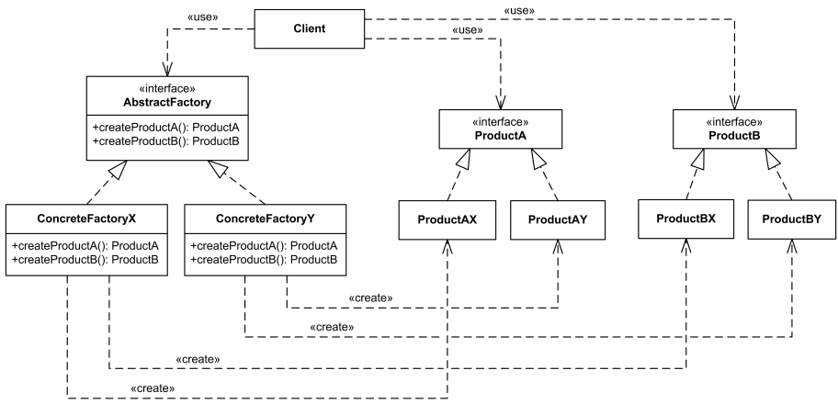
Abstract Factory Pattern

Slide 10
Abstract Factory Pattern
Usage
When a class cannot anticipate the class of objects it must create.
Or when you are unsure if similar classes will be added/removed.
When a class wants its subclasses to specify the objects it creates.
When you want a class to localize the knowledge of which helper subclass is the delegate.

Slide 11
Abstract Factory Pattern
Typically the most frequently used/applied pattern in OO languages.
Interfaces
Consequences
Isolates concrete classes.
Makes interchanging product families easy.
Promotes consistency.
Extendibility

Slide 12
Quiz #10

Slide 13
Command Pattern

Slide 14
Command Pattern
Let’s assume we are using conditionals for determining how to handle the various different operators as part of our calculator.
This can lead to very cluttered code – it provides a solution but it is neither agile not extendible.
What if we want to add a new operator later – we will.
Let us take a look at some sample code to help us better understand how/why…

Slide 15
Command Pattern
bool evaluate_postfix (Expr_Iterator & iter, int & result) {
Stack <int> s;
for (; !iter.is_done (); iter.advance ()) {
switch (iter->tag_)
case OPERATOR:
int n1 = r.pop (), n2 = r.pop ();
switch ((*iter).op_) {
case ‘+’: r.push (n2 + n1); break;
case ‘-’: r.push (n2 – n1); break;
case ‘*’: r.push (n2 * n1); break;
case ‘/’: r.push (n2 / n1); break;
}
case NUM:
r.push (iter->num_); break;
default:
return false;
}
result = s.pop ();
return true;
}
We notice some common behavior here between our various operators. What can we do about this?
For numbers we are simply pushing to the stack.

Slide 16
Command Pattern
For all cases, we either pushing a number onto the stack, or removing numbers from the stack.
If we think about the role of the Command design pattern we notice this would be a perfect application.
Let’s see how we can modify our code to properly reflect this…

Slide 17
Command Pattern
Since each operation is modifying on the stack, we can assume each operation is a command that operates on the stack.
In order to realize this, let’s create a pure abstract class (interface).
class Expr_Command {
virtual bool execute (Stack <int> & stack) = 0;
}

Slide 18
Command Pattern
We can then define each of our concrete commands in terms of this abstract command.
class Add_Command : public Expr_Command {
virtual bool execute (Stack <int> & s){
int n1 = s.pop (), n2 = s.pop ();
s.push (n1 + n2);
}
}
class Num_Command : public Expr_Command {
Num_Command (int n): n_ (n) { }
virtual bool execute (Stack <int> & s){
s.push (this->n_);
}
}

Slide 19
Command Pattern
Now, instead of our expression evaluator being required to have the concrete logic coded into its method we can simply call the execute() function.
The expression evaluator no longer cares how the algorithm is completed – just that it is completed correctly.
The same result is achieved but we have improved the overall design of our code and made it more flexible and extendible.

Slide 20
Command Pattern
Hints:
You should have a ‘Command’ for each operator that we are dealing within the calculator:
Add
Subtract
Multiply
Divide
Modulus
Number
There is a way of improving this approach through the use of another related pattern…

Slide 21
Abstract Factory Pattern

Slide 22
Abstract Factory Pattern
Motivation:
What we know:
We know that the expression the calculator evaluates is in infix format (e.g. 15 + 7).
We know that we need to convert this postfix in order to improve the runtime of our program (e.g. 15 7 +).
We now know that each “entity” can be represented as a command in the system (e.g. Command Pattern).
We just need to figure how to convert the infix expression (string) into a postfix expression (an array of command elements in postfix order).

Slide 23
Abstract Factory Pattern
Since the expression is given in infix format, the goal is to parse the expression an “create” the appropriate Command object for each entity that is parsed.
Example:
Given the infix expression 15 + 7
We need to apply a parser to create the following:
<Number_Command><Number_Command><Add_Command>
Each element in the Array is a result of the “create” operation.

Slide 24
Abstract Factory Pattern
We can then create the necessary interface for creating such objects:
class Expr_Command_Factory
{
public:
virtual ~Expr_Command_Factory (void) = 0;
virtual Number_Command * create_number_command (int num) = 0;
virtual Add_Command * create_add_command (void) = 0;
// ...
private:
// prevent the following operations
Expr_Command_Factory (const Expr_Command_Factory &);
const Expr_Command_Factory & operator = (const Expr_Command_Factory &);
};

Slide 25
Abstract Factory Pattern
Let’s review the previous slide:
We have made this a pure abstract class (aka an interface) which means any subclass that uses this MUST override the defined methods.
We used the benefit of “private” to prevent unwanted access to the operations in all of the subclasses.

Slide 26
Abstract Factory Pattern
class Stack_Expr_Command_Factory : public Expr_Command_Factory
{
public:
virtual ~Expr_Command_Factory (void);
virtual Number_Command * create_number_command (int num);
virtual Add_Command * create_add_command (void);
virtual Subtract_Command * create_subtract_command (void);
};
In the subclass now we can/have to implement each method – this method returns a concrete object.

Slide 27
Abstract Factory Pattern
bool infix_to_postfix (const std::string & infix,
Expr_Command_Factory & factory,
Array <Command *> & postfix) {
std::istringstream input(infix); // create a input stream parser
std::string token; // current token in string/stream
Command * cmd = 0; // created command object
Stack <Command *> temp;
while (!input.eof ()) {
input >> token;
if (token == “+”)
cmd = factory.create_add_command ();
else if (token == “-”)
cmd = factory.create_subtract_command ();
// ...
// handle the command based on infix-to-postfix algorithm
}
return true;
};

Slide 28
Abstract Factory Pattern
The client uses the infix_to_postfix conversion algorithm as follows:
// Get input from STDIN
std::string postfix;
// Concrete factory.
Stack_Expr_Command_Factory factory;
Array <Command *> postfix;
infix_to_postfix (infix, factory, postfix);

Slide 29
Abstract Factory Pattern
Hints:
Expression Command Factory
We need to create different types of commands that contain concrete types.
Stack Expression Command Factory
Inherits from Expression Command Factory
Dealing with the Commands on the Stack.
Pure Virtual Functions
Abstract Class (e.g. Interface)

